Slide 1
WELCOME TO MY PRESENTATION
Important monuments and structures (bridges)
in Bangladesh

Slide 3
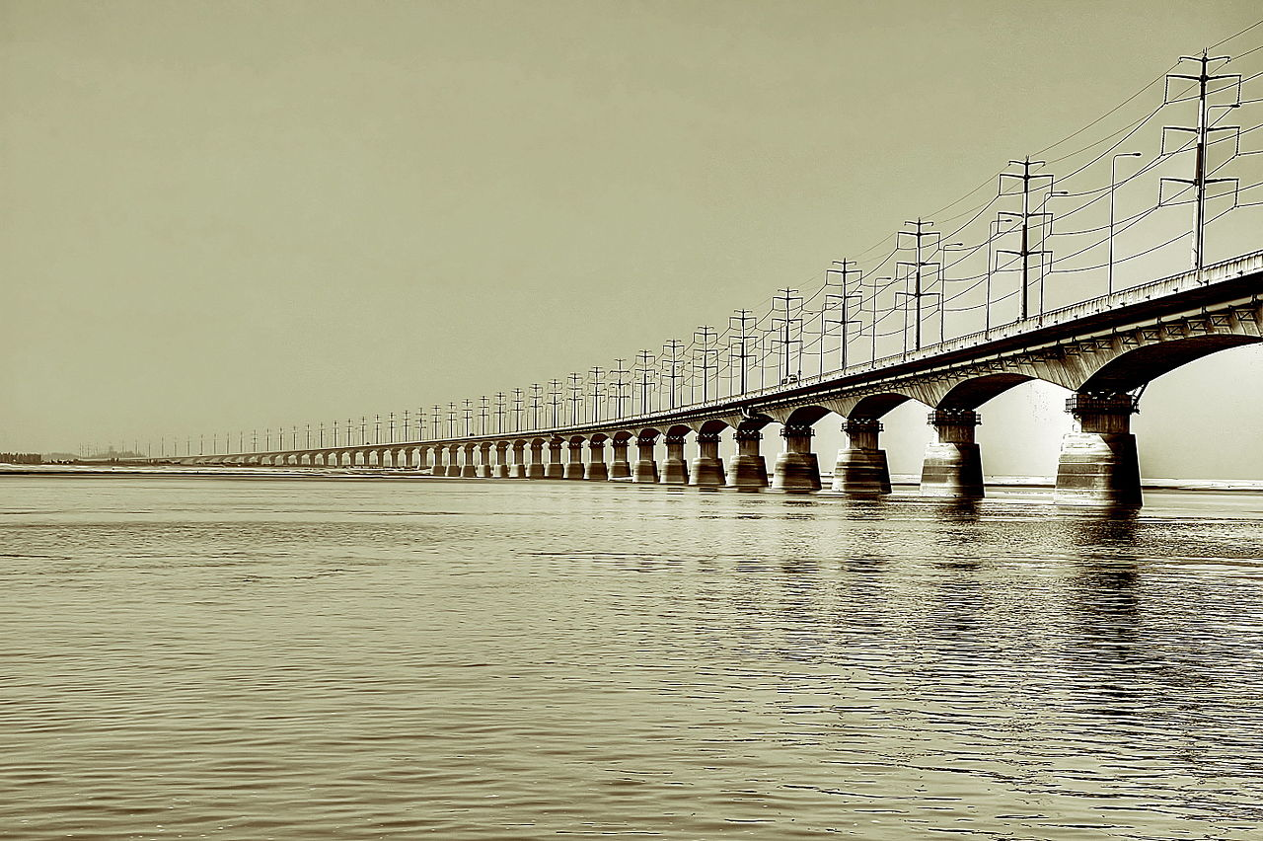
Bangabandhu Bridge
Bangabandhu Bridge, commonly called the Jamuna Multi-purpose Bridge WHICH is opened in Bangladesh in June 1998.
The main bridge is 5.63 kilometers (3.50 mi) long with 49 main spans of approximately 100 meters and two end spans of approximately 65 meters.
The bridge is supported on tubular steel piles, driven into the river bed. Sand was removed from within the piles by airlifting and replaced with concrete.

Slide 4
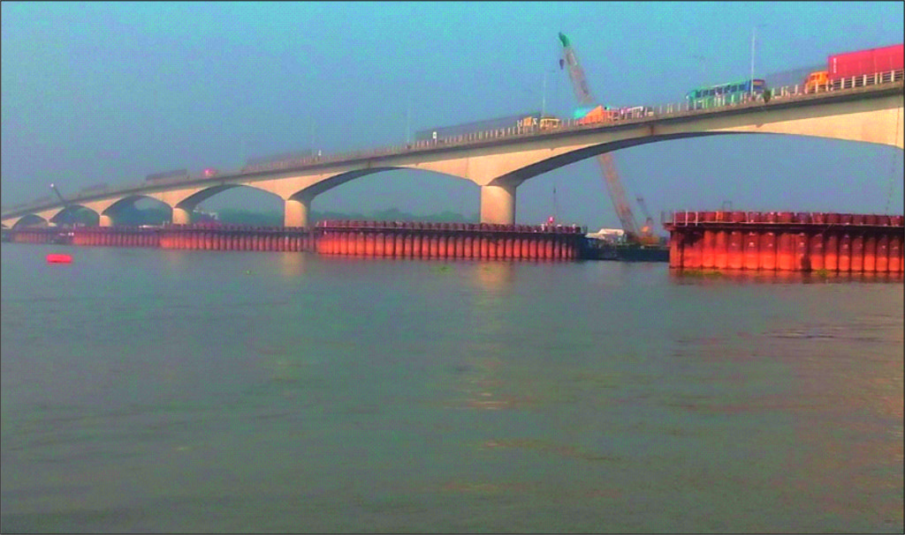
Meghna Bridge
Meghna Bridge is a road bridge in Bangladesh. It was built with the assistance of Japan and officially named Japan Bangladesh Friendship Bridge.
Meghna Bridge is 30 kilometers (19 mi) southeast of Dhaka across the Meghna River which is one of the major rivers in the country. The bridge is located along the Dhaka–Chittagong Highway.
It is 930 meters (3,051 ft. 2 in) in length with dual carriageway and 9.2 meters (30 ft. 2 in) in width. The bridge has thirteen spans. Two among the individual spans are of 24.25 meters (79 ft. 7 in) in length each, one is of 48.3 meters (158 ft. 6 in) in length, nine spans are of 87 meters (285 ft. 5 in) in length each and the length of the rest is 18.2 meters (59 ft. 9 in)

Slide 5
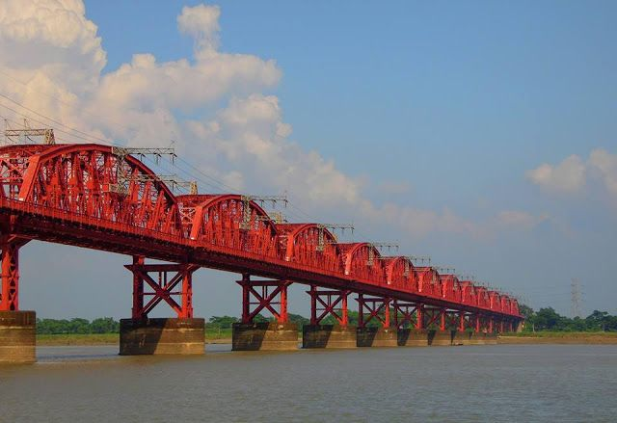
Hardinge Bridge
Hardinge Bridge is a steel railway bridge over the river Padma located at Ishwardi, Pabna and Bheramara, Kushtia in Bangladesh.
It is named after Lord Harding, who was the Viceroy of India from 1910 to 1916. The bridge is 1.8 kilometers (1.1 mi) long.
Construction of the through truss bridge began in 1910, though it was proposed at least 20 years earlier.
The construction of a railway bridge over the Padma was proposed in 1889 by the Eastern Bengal Railway for easier communication between Calcutta and the then Eastern Bengal and Assam.

Slide 6
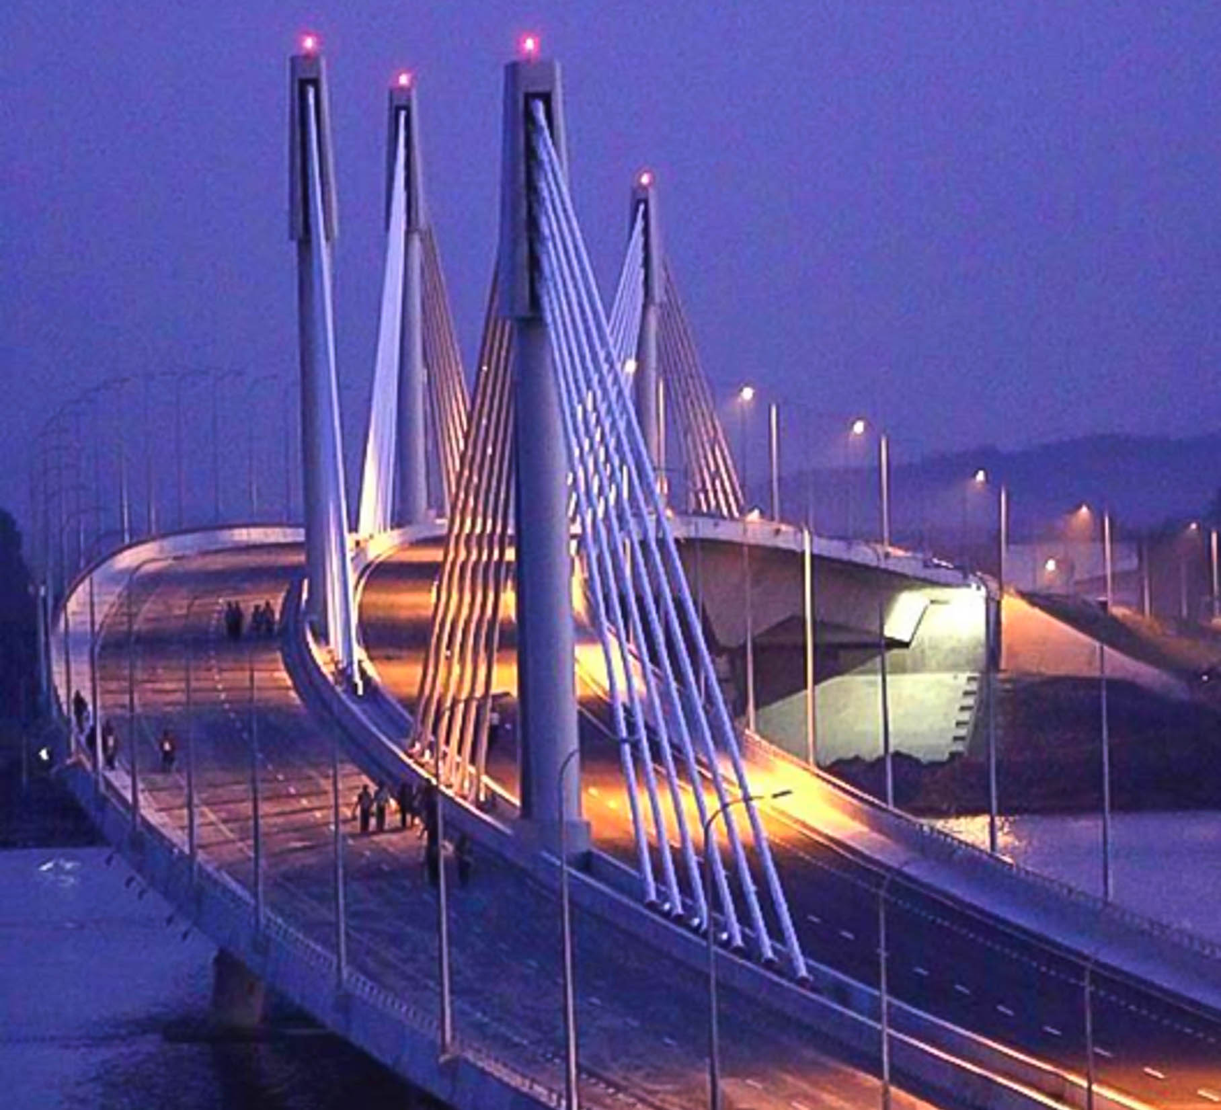
Shah Amanat Bridge
Shah Amanat Bridge, the second constructed across the Karnaphuli River in Bangladesh, is the first major extradosed bridge in the country.
is located along country's busiest national highway N1. It connects the southern parts of Chittagong, Cox's Bazar, and the hill district Bandarban.It is named after Chittagong's 18th-century Islamic preacher Shah Amanat.
Construction of the bridge started in August, 2006 and it was officially opened on September 8, 2010. The Chinese construction company, "Major Bridge Construction, China," built the bridge. The project involved a cost of Taka 590 crore, including a foreign exchange component of Taka 3.72 billion provided by the Kuwait Fund.
The bridge is 950 m long and 24.47 m wide. It has five piers with three 200 m extradosed main spans, two 115 m side spans and a 130 m approach viaduct section.

Slide 7
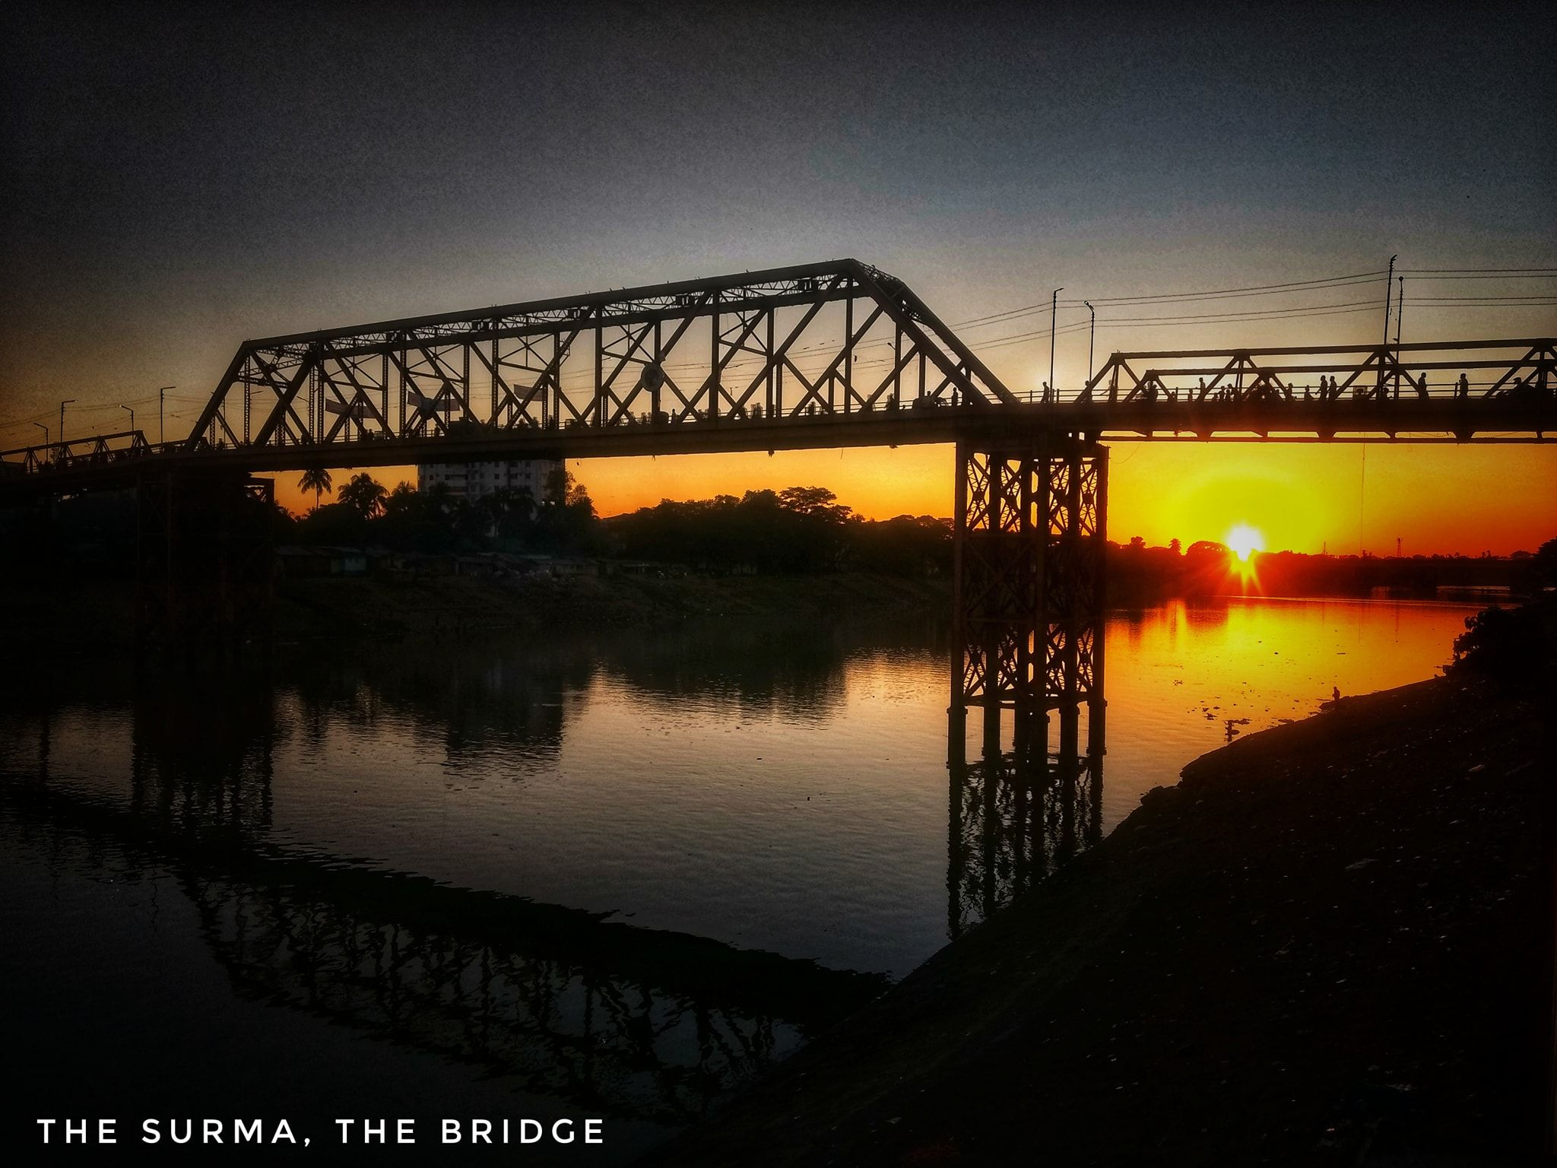
Keane Bridge
The Keane Bridge is a notable landmark of Sylhet city, Bangladesh. This bridge is called the gateway to Sylhet city.
This bridge is located over the Surma River at the middle of Sylhet city which is 246 kilometres (153 mi) northeast of Dhaka, the capital of Bangladesh.
This bridge was built in 1936 and is named after Sir Michael Keane who was the English Governor of Assam from 1932 to 1937.
It is made of iron and steel and looks like a bow. The bridge is 1150 feet long and 18 feet breadth. About Taka 5.6 million was spent to build the bridge.

Slide 8
Sources –
1.https://en.wikipedia.org/wiki/Bangabandhu_Bridge
2.https://en.wikipedia.org/wiki/Meghna_Bridge
3.https://en.wikipedia.org/wiki/Hardinge_Bridge
4.https://en.wikipedia.org/wiki/Shah_Amanat_Bridge
5.https://en.wikipedia.org/wiki/Keane_Bridge

